Slide 1
RESUMES

Slide 2
CAREER & PROFESSIONAL DEVELOPMENT CENTER
Career Studio | Coaching | Resources | Events
801-581-6186 • careers@sa.utah.edu • careers.utah.edu • @uofucareers

Slide 3
WHERE ARE YOU AT WITH RESUMES?

Slide 4
AGENDA
What is a resume?
What does it look like?
What is included?
How can I improve it?
Q&A

Slide 5
WHAT IS THE PURPOSE OF A RESUME?

Slide 6
RESUMES SHOULD BE…
CONCISE ACCOMPLISHMENT DRIVEN TAILORED

Slide 7
LOG YOUR STRENGTHS
Use the worksheet to list your experiences, and the strengths you demonstrated in each.

Slide 8
CONCISE

Slide 9
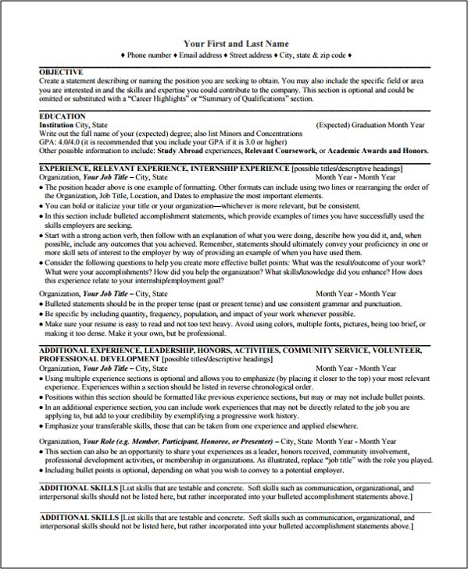
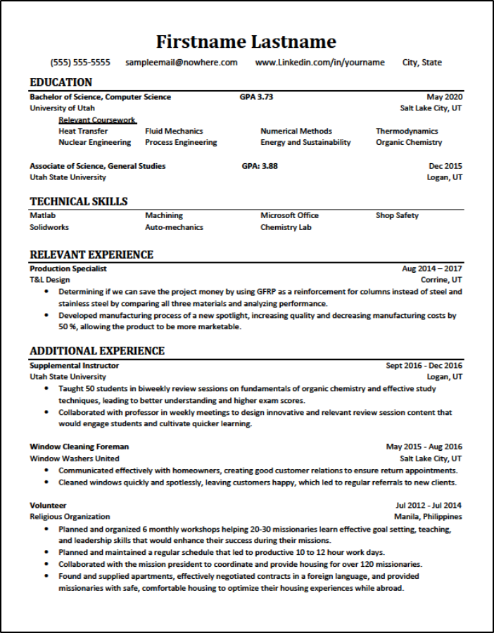

Slide 10
RESUME REVIEW
Look at the example resumes and decide what you like, what you don't like, and why.

Slide 11
SECTION BASICS
Heading
Education
Experiences (Professional and Extracurricular)
Optional/Additional Sections

Slide 12
FORMATTING BASICS
Margins: 0.5" - 1"
Font size: 10-12 pt
Fonts to use: Calibri, Arial, Helvetica, or Times New Roman
NO Templates

Slide 13
ACCOMPLISHMENT DRIVEN

Slide 14
WHAT ARE ACCOMPLISHMENT STATEMENTS?
Impact Verb + Task + Context

Slide 15
CANDIDATE COMPARISON
Think about who you would want to interview based on these two candidates.

Slide 16
Candidate #1
Candidate #2
Answered questions from students and staff
Assisted with scheduling appointments for students with staff
Responsible for office functions such as organizing paperwork and supplies
Addressed student and staff questions by providing information and referrals
Scheduled appointments for students with staff in Outlook and ConexEd
Supported office functions by ensuring paperwork and supplies stay organized

Slide 17
TAILORED

Slide 18
ATS, EXPLAINED

Slide 19
KNOWING WHAT TO INCLUDE
Look at the job description and think about what buzzwords you would use in your resume.

Slide 20
Job Description:
Brainstorming and creating content/recruit writers the blog stream, and writing at least two blogs/month.
Be responsible for coordinating communications pieces of travel.
Contributing to social media content and strategy, being responsible for Facebook posts as assigned, and leading team efforts surrounding Twitter scheduling, Tweetstorms, and live Tweeting.
Tracking media appearances and disseminating that information via a media round up, social media, and website.

Slide 21
QUESTIONS?

Slide 22
SO, NOW WHAT?
Finish Log Your Strengths worksheet.
Create and format your resume.
Stop by the Career Studio for a review.
ACTION STEPS

Slide 23
DROP BY THE CAREER STUDIO Resume & Cover Letter Help | Career Exploration | Job & Internships Search SSB 350: M: 9am-1pm | T: 9am-1pm & 5pm-7pm | W/TH: 3pm-5pm | F: 10am-2pm
MEET WITH A CAREER
COACH
To get personalized support, please make an appointment at careers.utah.edu

Slide 24
LOGGING INTO HANDSHAKE
Activate your Handshake account at
utah.joinhandshake.com | CIS | Handshake app
Sign in anytime to…
Explore internship and job opportunities
View and attend events
Access career resources
Schedule an appointment with a Career Coach

Slide 26
ASSESSMENT

